Slide 1

Use of Psychopharmotropic Drugs in Children and Adolescents
RL Tackett, PhD
University of Georgia
College of Pharmacy

Slide 2
Pediatric Pharmacology: Reality
“Clinical practice in child and adolescent psychiatry often precedes clinical research in the development of new treatment interventions.”

Slide 3
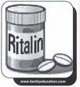
Recent Trends
Children are more likely to receive pharmacotherapy
  ADHD
  Obsessive – compulsive disorder
  Mood disorder
Pharmacological treatment more commonly continued for several years

Slide 4
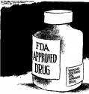
Safer Medications (?)
Better risk:benefit ratio
SSRIs do not have cardiac toxicity of TCAs
Atypical antipsychotics have fewer extrapyramidal side effects than older typical agents

Slide 5
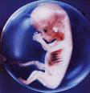
Pediatric Pharmacology: Concerns
Impact of Development
Unique side effects of medications
  Aspirin – Reye’s syndrome
  Tetracycline - discoloration of teeth

Slide 6
Major Questions to Consider
Are there age-related differences in the pharmacokinetics, safety and efficacy of medications?
Are the disorders being treated the same or similar to adult counterparts?

Slide 7
Pediatric Psychopharmacology
Children are “therapeutic orphans”
  Safety and efficacy research largely undetermined
  Treatment decisions based on case reports, small pilot studies, or downward extrapolations from adult data

Slide 8

Ethics of Pediatric Psychopharmacology
“Do no harm”
No firm data exists to support clinical use does not exclude medication use
FDA approval exists does not necessitate medication use

Slide 9
ADHD
Specific definition has been modified 3 times in 14 yrs by American Psychiatric Association
Increasing agreement that ADHD is a ‘real’ condition rather than an artifact of unreasonable expectations and crowded classrooms

Slide 10
ADHD
Other behavior disorders frequently occur with ADHD
  Oppositional defiant disorder (children say no to everything) - 60%
  Conduct disorder - 20%
  Learning disabilities - 50%
Some symptoms of other psychiatric disorders may mimic ADHD
  Mood disorders
  Psychotic disorders

Slide 11
ADHD: Prevalence
Wide range of variation in incidence due to:
Differences in informants (parents or teachers)
Culture (differences in awareness)
Degree of impairment needed for diagnosis

Slide 12
ADHD: Treatment
Response to stimulant therapy is not diagnostic ADHD
  Normal individuals show similar responses

Slide 13
ADHD: Treatment Controversy
Increase in prescriptions may reflect:
Greater awareness of disorder
Increase in diagnosis among females
Increased recognition of inattentive subtype
Continuation of treatment into adolescence and adulthood

Slide 14
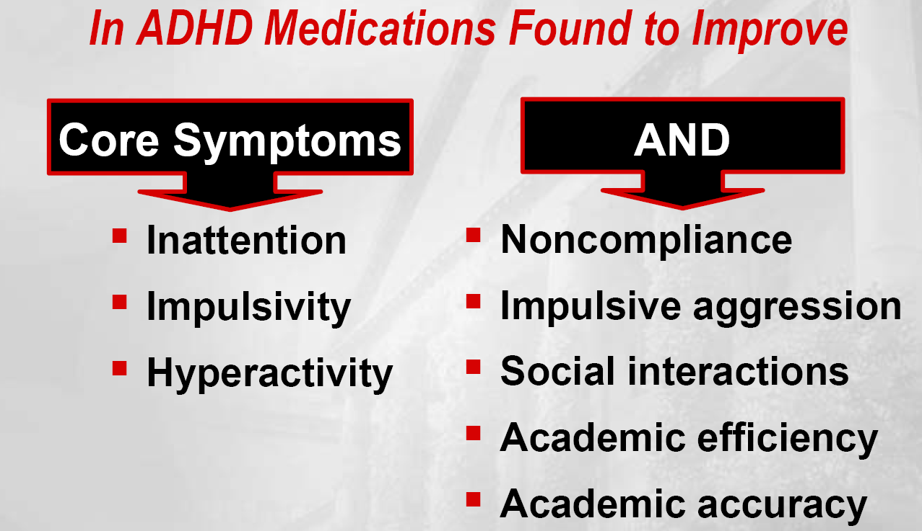
Zametkin &Ernst NEJM 1999

Slide 15
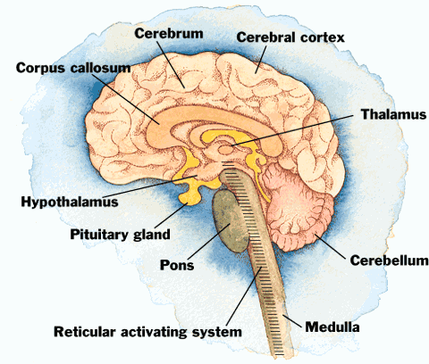
Pathophysiology
Dysfunctional circuits
  Frontal cortex
  RAS
  Limbic

Slide 16
ADHD: Pharmacologic Substrate
DA dysregulation produces deficits in response inhibition
NE dysregulation produces deficits in attention
All currently available drugs modulate NE and/or DA

Slide 17
ADHD: Stimulants
Methylphenidate (Ritalin, Ritalin-SR,Quillivant,Metadate, Daytrana)
Dexmethylphenidate (Focalin)
Dextroamphetamine (Dexedrine, Dextrostat, Oxydess. Dexdrine spansules, Spancap)
D-amphetamine + amphetamine (Adderall)
Pemoline (Cylert) WITHDRAWN
Methamphetamine (Desoxyn)

Slide 18
ADHD Drugs
Lisdexamfetamine (Vyvanse)
TCAs (amitriptyline, desipramine, imipramine, nortriptyline)
Alpha 2 agonists (clonidine [kapvay], guanfacine [intuniv])
Bupropion (Wellbutrin)
Modafinil (Provigil)
Atomoxetine (Strattera)

Slide 19
ADHD Drugs: DAT
Selective and principal target of most drugs
DA hypofunction in frontal cortex and basal ganglia is believed to be neurobiological feature of ADHD
DAT gene associated with ADHD
Abnormal levels of DAT have been detected in ADHD subjects in some studies

Slide 20
ADHD: Generalizations about Dosing
Academic performance may improve with low dose but higher doses may be required for improvement of motor restlessness and attention
Assess adverse effects, behavior and academic function through reports from teachers or parents before altering dose

Slide 21
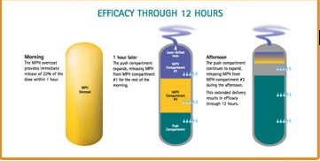
Concerta
Extended release methylphenidate
Tablet uses osmotic technology
Duration 12 hrs
Peak plasma levels 6-8 hrs

Slide 22
Methylphenidate: Warnings
Do not use for severe depression
Do not use for treatment of fatigue
May lower seizure threshold
Use cautiously in hypertensive patients
May affect accommodation and produce blurring of vision

Slide 23
Methylphenidate: Warnings
May exacerbate behavior disturbances and thought disorders in psychotic children
May slow weight gain and growth slightly but long term effects are minimal (may be related to ADHD and independent of therapy)

Slide 24
Methylphenidate: Side Effects
Dose dependent
Decreased appetite in 80% of children - usually mild and limited to daytime eating
Substantial weight loss in 10-15% of children
Insomnia (3-85% of children)
  Sleep delays of about an hour

Slide 25
Dexmethylphenidate (Focalin)
D isomer
Duration of activity ~ 4 hrs
Dosages available: 2.5, 5, 10 mg
Some patients may tolerate better than other forms of methylphenidate

Slide 26
D-amphetamine: Side Effects
CVS - tachycardia, hypertension, arrhythmias
CNS - overstimulation, restlessness, insomnia, psychotic episodes, euphoria, changes in libido
GI - dry mouth, unpleasant taste, constipation, anorexia, weight loss

Slide 27
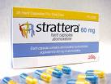
Atomoxetine
Currently considered 2nd line treatment in ADHD after stimulants
Considered appropriate treatment when adequate trials with two stimulant drugs have failed

Slide 28
Atomoxetine: SE and ADR
Side effect profile is very similar to that of stimulant drugs
Greater risk of fatigue and sedation
Labeling was recently updated to include:
  Bolded warning of the potential for severe liver injury
  Black Box Warning of the potential for suicidal ideation in children under 12

Slide 29
Stimulants: Adverse effects
At doses given to patients with ADHD
  Euphoria does not occur
    Oral dosing
    Pharmacokinetics
  Physiologic and psychological dependence is rare

Slide 30
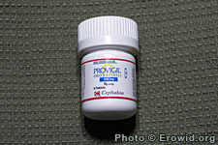
ADHD: Modafinil
Mechanism is unclear but may
  Enhance histamine release
  Affect alpha-1 receptor function w/out affecting DA activity
Has been used to promote wakefulness in narcolepsy
Has shown efficacy against ADHD at 300 mg/d

Slide 31
ADHD: Modafinil
Common side effects
  Insomnia
  Abdominal pain
  Anorexia
  Cough
  Fever
  Rhinitis

Slide 32
General Principles of Medical Intervention
Parents of school-age children may be reluctant to use medications and may be concerned or afraid of drug effects
  Start medications at low dosages to avoid side effects
  Low dosages increase the need for interactions with families early in treatment

Slide 33
General Principles of Medical Intervention
Initially use medications 7 days a week so parents can observe child under the influence of the drug
Accept that many doses may be missed
Behavior of school children varies from hour to hour and day to day, positive and negative effects need to be consistently observed before attributed to medication

Slide 34
Reasons for treatment failure
Small number of children cannot tolerate the drugs
Noncompliance
Over-reporting of side effects by parents weary of medication
Attempting to treat symptoms other than the core symptoms of ADHD

Slide 35
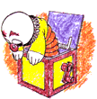
Depression
Major depression is rare among children but more common in youth and adolescents (Epidemiological studies)
Primary clinical presentation:
  Feeling blue
  Depressed mood
  Tired
  Feel life is not worth living
  Poor appetite

Slide 36
Antidepressants
TCA’s considered to have little or no efficacy
Efficacy of SSRIs reported to be similar to that seen in adults
SSRIs considered first line treatment

Slide 37
Antidepressants: Suicide Risk
June 2003 – Britain’s Medicines and Healthcare Products Regulatory Authority (MHRA)
  Paroxetine (Paxil) should not be used in children due to lack of efficacy and increased risk of suicide (1.5-3.2 x increased risk)
  Banned pediatric use of all SSRIs other than fluoxetine (Prozac)

Slide 38
Antidepressants: Suicide Risk
FDA’s response to MHRA’s ruling:
  “ Although the FDA has not completed its evaluation of the new safety data, the FDA is recommending that Paxil not be used in children and adolescents for the treatment of Major Depressive Disorder."

Slide 39
FDA Approved Antidepressants for Children
Clomipramine – OCD – 10 and older
Duloxetine (Cymbalta) – General Anxiety disorder - 7 and older
Escitalopram (Lexapro) – Major Depressive disorder – 12 and older
Fluoxetine (Prozac) - Major depressive disorder; OCD – 7 and older, 8 and older
Fluvoxamine – OCD – 8 and older
Olanzapine/fluoxetine (Symbyax) – Bipolar Depression- 10 and older
Sertraline (Zoloft) – OCD – 6 and older

Slide 40
Antidepressants: Suicide Risk
American College of Neuropsychopharmacology (ACNP) evaluated and concluded that SSRIs do not increase the risk of suicidal thinking or suicide attempts and that the benefits of SSRIs for treating childhood depression outweigh the risks of suicidal behavior.

Slide 41
Antidepressants: Suicide Risk
February 2004 – FDA Psychopharmacological Drugs Advisory Committee and Pediatric Subcommittee Meeting
  American Academy of Child and Adolescent Psychiatry supported the ACNP task force conclusions and implicated depression itself as the most likely cause of suicide
  Anderson and Navalta, 2004

Slide 42
Antidepressants: Onset of Action
Clinical effect is usually not manifest for 1-3 weeks
Clinical rule is usually to treat patient for a minimum of 6 wks at an adequate dosage before changing
Synaptic effects occur immediately (hrs)
Adverse effects have same time course as synaptic effects

Slide 43
Children: Antipsychotics
Diagnosis is still a major problem and contributes to questions in literature
Rule out substance abuse
Mania shares symptoms with
  ADHD
  Depression and anxiety

Slide 44
Children: Antipsychotics
Many of the drugs are used to treat nonpsychotic states:
  Aggression
  Hyperactivity
  Tourette’s
Use of these agents has increased
MOA: D2 and 5HT2 receptor blockade

Slide 45
Children: Antipsychotics
Controlled studies are lacking but needed
Difficult to assess the effects that antipsychotics have on learning and cognition
Drugs may need to be withdrawn periodically to assess for dyskinesias
Major concern is weight gain and hyperglycemia

Slide 46
Pharmacotherapy in Learning Disabilities
Behavioral and emotional problems are 2-3x more common in patients with learning disabilities
Unusual for psychotropic medications alone to be sufficient
Identify precise target symptoms for which the psychotropic medication is being prescribed

Slide 47
Pharmacotherapy in Learning Disabilities
Try to reduce dosages if target symptoms are reduced or absent for a reasonable period
Patients are kept on meds for fear that symptoms will recur
Do not withdraw medication abruptly

Slide 48
Pharmacotherapy in Learning Disabilities
Start with small dosages initially
The presence of organic brain dysfunction often predisposes the patient to adverse drug effects

Slide 49
Learning Disabilities: Antipsychotics
Some evidence that antipsychotics reduce challenging behaviors but with significant side effects
Frequently cause sedation, compromise cognitive function and self-help skills
Newer atypical agents have not been proven to be more efficacious but may have a lower side effect incidence

Slide 50
Learning Disabilities: Antipsychotics
Side effects of concern
  Tardive dyskinesia
  Elevated liver enzymes
  Weight gain
  Hyperglycemia
Akathisia is of particular concern
  Patients have limited verbal skills to describe symptoms and this can be distressing and lead to agitation
  Agitation may promote increased dosages which can worsen the problem
Neuroleptic malignant syndrome is double that of those without learning disabilities

Slide 51
Learning Disabilities: Antidepressants
Depression can be difficult to diagnose due to limited verbal skills
SSRIs have been used in this population
  Agitation and nausea are common side effects
  Liquid dosage forms allow better titration of dose

Slide 52
Learning Disabilities: Anxiolytics
Limited work in this area
SSRIs have shown some benefit
Benzodiazepines often cause disinhibition and irritability in patients with organic brain impairments
Clonidine can be used to produce sedation and calming in children
  Dose should be less than 5 ug/kg
  Monitor blood pressure

Slide 53
Learning Disabilities: Mood Stabilizers
Instability of mood is often seen in patients with learning disabilities rather than manic –depression
  Rapid alternation between irritability, excitement, and high levels of activity and withdrawal and loss of interest
  Lithium has been used successfully
Caution in Down’s syndrome with Lithium due to hypothyroidism which is common

Slide 54
Autism: DA Antagonists
Decrease motor symptoms (hyperactivity, fidgetiness, stereotypical behavior)
May facilitate learning but does not worsen learning
Improves behavior so patients may remain with families
High rate of dyskinesias (75% after 41 mos of treatment)

Slide 55
Autism: Antipsychotics
Haloperidol
  Reduces aggression
  Adverse effects
    Sedation
    Muscle stiffness
    Abnormal movements
Risperidone
  Effective and well tolerated
  Increased weight gain, sedation
Olanzapine and ziprasidone are promising – no significant weight gain with ziprasidone

Slide 56
Autism: SSRIs
Hypothesized that autism involves dysfunctional 5-HT system
Improve autistic symptoms
Decreases stereotypical behavior
Decreased anger, hyperactivity and compulsive-ritualized behavior
Monotherapy or to augment neuroleptics when obsessive-compulsive behavior is present

Slide 57
Summary
Safety and efficacy of drugs in children and adolescents has not been determined for many drugs even though use is increasing
Many of the clinical studies have small numbers of patients, are short-term and lack appropriate controls.
Clinical endpoints need to be identified and monitored

Slide 58
OTC Meds - Children
Antihistamines
  Sedating – Diphenydramine
  Nonsedating – Clorpheniramine
  CNS Stimulation
  Abuse
Analgesics – Ibuprofen, naproxen, Acetaminophen
  Skin reactions
  Liver toxicity
Cough cold preparations
  Alcohol content
  Dextromethorphan

Slide 59
Supplements and herbs
Safe?
Controlled by the FDA?
Drug interactions
Side effects

Slide 60
MedWatch Program
Initiated in 1993
Goals of program
  Simplify reporting process
  Clarify what is to be reported to FDA
  Enhance awareness of serious side effects
  Provide feedback to healthcare providers

Slide 61
MedWatch Program
Not necessary to show direct causal relationship in the individual report
Information needed
  Patient
  Drug
  Adverse event
Reporting is simplified
  1-800-FDA-1088
  Prepaid mail form (FDA 3500)
  Fax: 1-800-FDA-0178
  Internet: www.fda.gov/medwatch

Slide 62
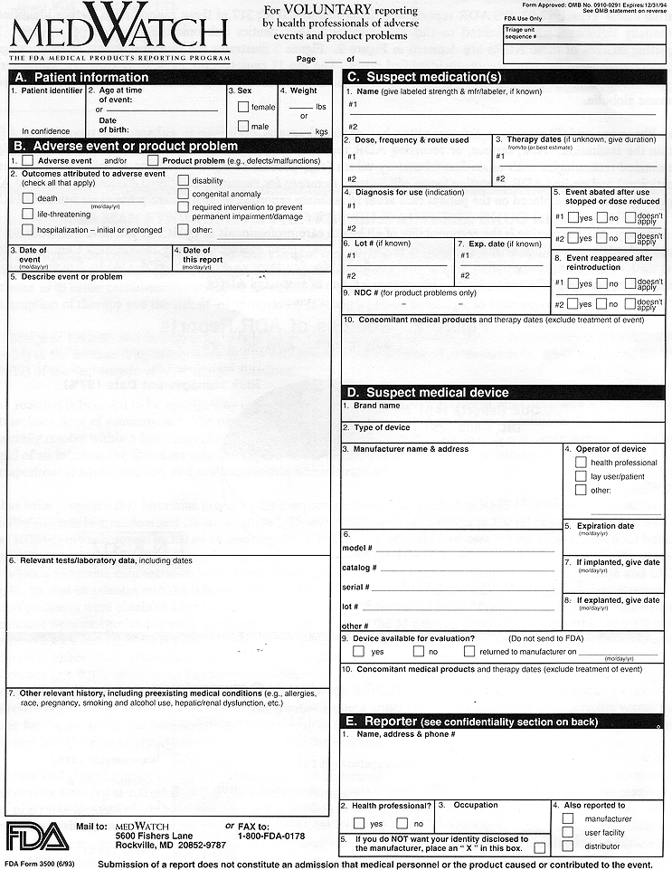
MEDWATCH FORM

Slide 63
DRUG ABUSE IN TEENS
RANDALL L TACKETT, PHD
UNIVERSITY OF GEORGIA COLLEGE OF PHARMACY
rtackett@me.com

Slide 64
Drugs of Choice
1967
Alcohol
Marijuana
Cocaine
Crank
LSD
Quaaludes
Glue
Designer drugs
Now
Alcohol
Marijuana
Cocaine
Methamphetamine
LSD
Rohypnol/GHB
Inhalants
Ecstasy
Prescription drugs
Bath Salts
Synthetic THC

Slide 65
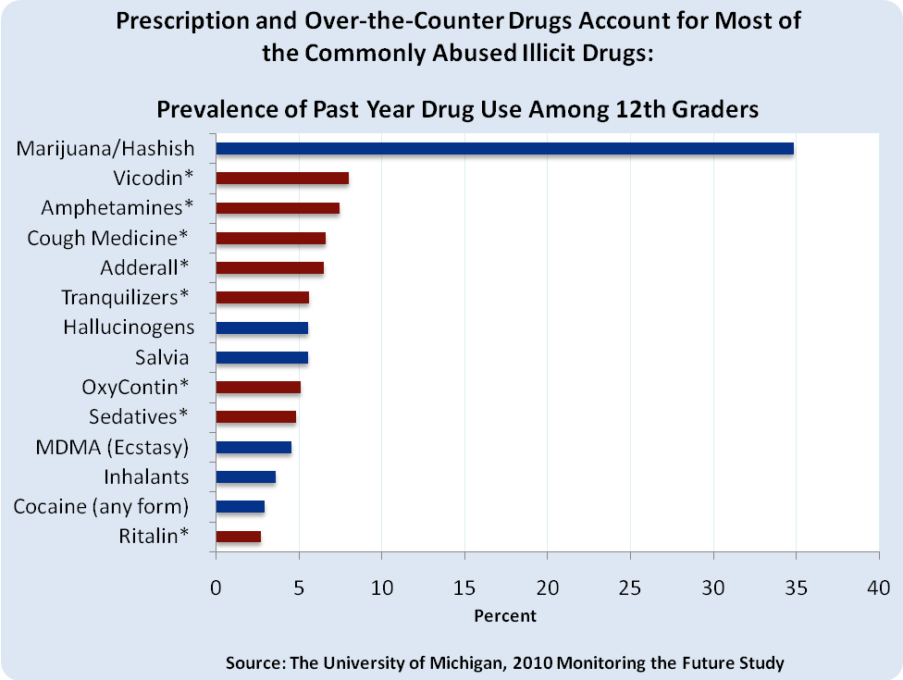

Slide 66
Commonly Abused Medications
Pain medications 5.3 million
Tranquilizers 2 million
Stimulants 1.3 million
Sedatives 0.4 million
NSDUH, 2009

Slide 67
Rx Drug Misuse in the U.S.
6.4 million aged 12+ used a
Rx drug (non-medically) in the past year
NSDUH, 2006
Notes:
So what does the Rx drug problem look like nationally?
-According to the NSDUH, approximately 6.4 million Americans (12 years and older) used a Rx-drug non-medically in the past year.
Of the 6.4 million:
4.7 million used opiate pain killers
1.8 million used tranquilizers & 272,000 used sedatives
1.1 million used stimulants
So, this is the general picture…

Slide 68

New Landscape of Drug Abuse among Teens
Marijuana
8.6 million
Prescription Medicine
4.5 million
Cough Medicine
2.4 million
Crack/Cocaine
2.4 million
Ecstasy
1.9 million
Meth
1.9 million
LSD
1.3 million
Heroin
1.1 million
Ketamine
1 million
GHB
1 million
NSDUH, 2006
Notes:
--The growing misuse of Rx and OTC drugs among youth groups have been well documented in national data sources (including the NSDUH & MTF).
--As the data show…there is a new landscape of drug abuse among teens.
--For the 1st time we are seeing that Rx drugs are the 2nd most abused drugs next to marijuana.
In the last year…
--Nearly 4.5 million (or 1 in 5 teens) reported abusing Rx drugs to get high.
--And 2.4 million (or 1 in 10 teens) reported abusing OTC medications to get high.

Slide 69
Why the high prevalence?
Misperceptions about safety
  Meds are prescribed by doctors
  FDA approved
Readily available
  1991-2010 – Stimulant prescriptions increased from 5 to 45 million
  1991-2010 – Opioid prescriptions increased from 30 to 180 million

Slide 70
Why the high prevalence?
Many different motivations for abuse
  Get high
  Counter anxiety
  Pain relief
  Sleep problems
  Enhance cognition

Slide 71

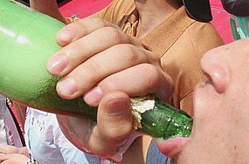
TEENS
“Teenagers define their identity through risk taking…” (Shedler and Block)

Slide 72
TEENS: Exploration
“…balance exploration with commitment to formulate a sense of identity”
Not trusting adults may represent a means of developing identity

Slide 73

The Adolescent Brain
OLD SCHOOL: The brain matures at puberty
NEW SCHOOL:
  During adolescence, brain is under construction
  50% of neuronal connections are lost in some brain areas
  New connections are formed
  Pruning occurs
      Children lose 20 billion synapses/day between early childhood and adolescence
      Streamlines mental processes

Slide 74
The Adolescent Brain
Maturing brain
  Generates connections that ehhance communication between brain regions
  Enable greater integration and complexity of thought
During adolescence, changes in brain areas responsible for emotion
  Increased novelty seeking
  Risk taking
  Peer-based interactions
These changes occur in all social animals and are responsible for
  Separation from safety and comfort of family
  Exploration of new environments
  Seek unrelated mates

Slide 75
Increased Connectivity
Cognitive advances in teens due to faster communication in circuitry and increased integration
“cells that fire together, wire together” (hebb, 1940)
Myelination increases, fine tuning the timing of the firing of the neurons (basis for thought, consciousness and meaning)
Myelination closes the window – decreased plasticity

Slide 76
Changes in Frontal/Limbic Balance
Limbic system (emotional) matures before the frontal lobe (executive thinking)
Areas involved in high level integration of information from various parts of the brain mature somewhat late (usually in the mid-20’s)

Slide 77
Learning Curve in Teens
Adolescent brain is under development – retains a large portion of plasticity
  Able to be molded by environment
  Plasticity boosts teen’s abilities to learn, make memories and retain information
Gender differences in learning
  Girls peak between 12-14 years of age
  Boys peak approximately 2 years later

Slide 78

Teens and Behavior
Teen frontal lobe is immature
Frontal lobe responsible for
  Judgement
  Insight
  Dampening of emotions
  Impulse control
Disconnect exists: Forms an idea but not able to determine if it’s actually a good idea!
This results in risk- taking and irrational actions

Slide 79
Teens and Behavior
Insight (ability to judge one’s own actions and predict consequences) develops in stages in the frontal lobe
First learn to judge other’s actions and see consequences but can’t recognize their own behavior as dangerous

Slide 80
Teen Brain and Drugs
Plasticity is paradoxical
  Allows teens to learn and retain a lot of information
  Makes them susceptible to negative influences
Process of addiction uses same neurochemistry as general learning
Specific neuronal connections form from exposure to stimuli (drugs, alcohol) and become irreversibly imprinted on brain

Slide 81
Brain Development
Cerebellum develops early (back of brain)
  Responsible for physical and motor coordination
  Involved in playing sports
Nucleus accumbens
  Responsible for motivation
  Addresses how much effort will someone expend to seek a reward
  Teens prefer activities that require low effort but produce high excitement (video games)

Slide 82
Brain Development
Amygdala
  Integrates emotional response to both pleasurable and aversive experiences
  May explain why youth
    React to situations with hot emotions rather than cool controlled emotions
    Propensity to misread neutral or inquisitive facial expressions as signs of anger
Prefrontal cortex
  “seat of sober thought”
  Responsible for complex processing, making judgements, controlling impulses, foreseeing consequences of actions, setting goals
  Developing PFC contributes to poor judgement and risk taking

Slide 83
Adolescent Brain
Prefrontal cortex
AMYGDALA
Decreased planned thinking
Increased impulsiveness
Decreased self control
Increased risk taking

Slide 84
Adolescent Brain and Stress
Prefrontal cortex
AMYGDALA
Stress accentuates the imbalance

Slide 85
Adolescent Brain After Pruning
PREFRONTAL CORTEX
Amygdala

Slide 86
Adolescent Brain + Hormones
Surge of hormones cause the amygdala to be hyperactive
Hyperactive amygdala + undeveloped prefrontal cortex = roller coaster ride

Slide 87
Adolescents and Sleep
Most adolescents need approximately 9 hrs of sleep
  Dendrites grow during sleep
  If enough sleep, all neurons fire and rehearse learning
Too little sleep impairs thinking ability
Teenagers are most sleep-deprived population

Slide 88
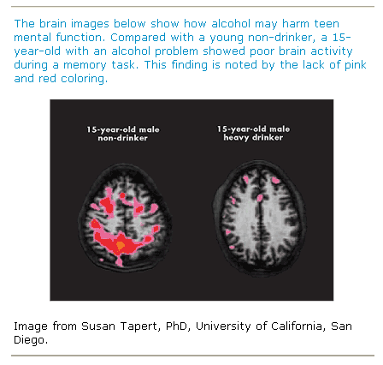

Slide 89
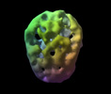
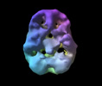
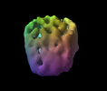
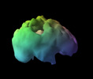
Alcohol Spect Scans
Alcohol Use of 7 Years

Slide 90
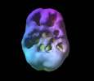
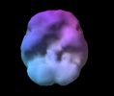
MARIJUANA:
16 y.o.
2 year history of daily abuse
Normal
underside surface view of prefrontal and temporal lobe activity
© 2006 Amen Clinics Inc

Slide 91

MARIJUANA:
18 y.o.
3 year history of 4x/week
Normal
underside surface view of prefrontal and temporal lobe activity
© 2006 Amen Clinics Inc
Notes:
91

Slide 92
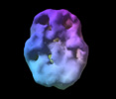
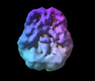
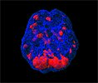
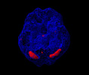
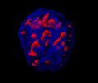
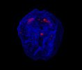
Marijuana Spect Scans
4 Years 7 Years 9 Years 12 Years
With Permission Amens Clinics

Slide 93
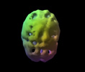
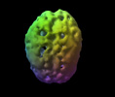
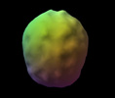
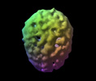
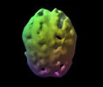
Stimulant Spect Scans
Cocaine Use 3 years
Methamphetamine Use 1 Year

Slide 94
Impact of Chemical Dependency
MARIJUANA & Memory:
16 y.o.
2 year history of daily abuse
underside surface view of prefrontal and temporal lobe activity
© 2006 Amen Clinics Inc

Slide 95
Prescription and OTC Drugs
Fastest growing problem in addiction
Readily available by prescription or from someone’s drug cabinet
Having a prescription does not mean the drug is not addicting
OTC drugs are considered safer but still a problem especially in adolescents
  Antihistamines
  Dextromethorphan
  Coricidin

Slide 96
Choices
Family
Profession
Spirituality
Friends
Freedom
Money
Honor

Slide 97
Mood Chart of the Human Brain
Mania
Homeostasis
Euphoria
Normal
Sadness
Depression

Slide 98
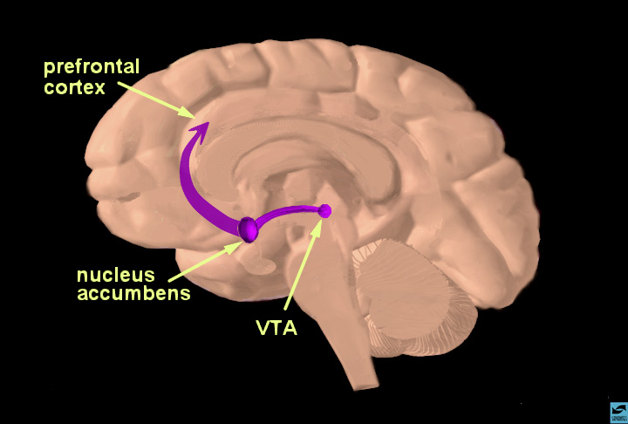
Notes:
Slide 9: The reward pathway
Tell students that this is a view of the brain cut down the middle. An important part of the reward system is shown and the major structures are highlighted: the ventral tegmental area (VTA), the nucleus accumbens (nuc. acc.) and the prefrontal cortex. Also, the pathway connecting these structures is highlighted. The information travels from the VTA to the nucleus accumbens and then up to the prefrontal cortex. Reiterate that this pathway is activated by a rewarding stimulus. [Note to scientists - this is not the only pathway activated by reward, other structures are involved too, but only this part of the pathway is shown for simplicity.]

Slide 99
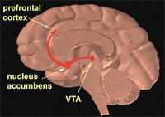
The Brain’s Reward System
Neurotransmitter = DA
Responsible for seeking natural rewards that promote survival
  Food
  Sex

Slide 100
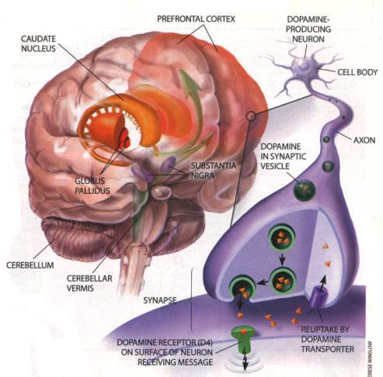
Drugs Hijack the Brain
Drugs immediately cause an increase in DA
Continued drug use reduces DA production
Brain is fooled into thinking that the drug is necessary for survival
Drug seeking behaviors occur

Slide 101
Natural Rewards Elevate Dopamine Levels
FOOD
SEX
200
200
NAc shell
150
150
DA Concentration (% Baseline)
100
100
% of Basal DA Output
15
Empty
10
50
Box
Feeding
Copulation Frequency
5
0
0
0
60
120
180
Female Present
Time (min)
Sample
Number
1
2
3
4
5
6
7
8
Mounts
Intromissions
Ejaculations
Di Chiara et al., Neuroscience, 1999.
Fiorino and Phillips, J. Neuroscience, 1997.
Notes:
101
Natural rewards increase dopamine neurotransmission. For example, eating something that you enjoy or engaging in sexual behavior can cause dopamine levels to increase. In these graphs, dopamine is being measured inside the brains of animals, its increase shown in response to food or sex cues. This basic mechanism has been carefully shaped and calibrated by evolution to reward normal activities critical for survival.

Slide 102
Natural Rewards Elevate Dopamine Levels
FOOD
SEX
200
200
NAc shell
150
150
DA Concentration (% Baseline)
100
100
% of Basal DA Output
15
Empty
10
50
Box
Feeding
Copulation Frequency
5
0
0
0
60
120
180
Female Present
Time (min)
Sample
Number
1
2
3
4
5
6
7
8
Mounts
Intromissions
Ejaculations
Di Chiara et al., Neuroscience, 1999.
Fiorino and Phillips, J. Neuroscience, 1997.
Notes:
102
Natural rewards increase dopamine neurotransmission. For example, eating something that you enjoy or engaging in sexual behavior can cause dopamine levels to increase. In these graphs, dopamine is being measured inside the brains of animals, its increase shown in response to food or sex cues. This basic mechanism has been carefully shaped and calibrated by evolution to reward normal activities critical for survival.

Slide 103
NARCAN PARTIES
GROUP GATHERINGS
GET HIGH IN HOUSES OR CARS IN PUBLIC PLACES
EMERGENCY RESPONDERS REVIVE WITH NARCAN
GIVES THEM A RUSH

Slide 104
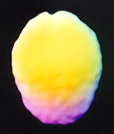
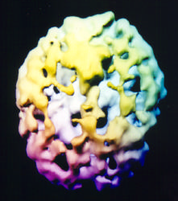
Brain Imaging SPECT
Normal brain view 39 y/o top down surface view, full symmetrical activity
39 y/o -- 25 yr. hx of frequent heroin use, top down surface view
marked overall decreased activity

Slide 105
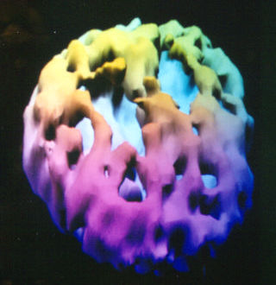
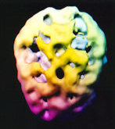
Brain Imaging SPECT
39 y/o -- 25 yrs. of frequent heroin use 40 y/o, 7 yrs. on methadone
heroin 10 yrs. prior

Slide 107
Killer Heroin
Tainted heroin
Laced with fentanyl
May actually contain little or no heroin
Brand names
  “Bad News”
  ”Theraflu”

Slide 108
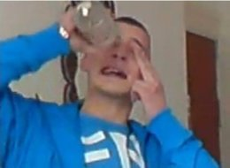
“Eyeballing”
Originated in England
Vodka poured directly in eye
Believed that the vodka is absorbed faster across the mucous membranes in eye and the blood vessels in eye
Faster absorption does not occur
Damage to eye can occur

Slide 109
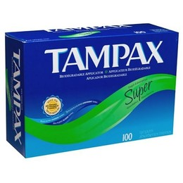
“In the news…
Alcohol Enemas – Butt Chugging
Vodka soaked tampons

Slide 110
Sample of Products with DXM
Alka-Seltzer Plus Cold & Cough medicine
Coricidin HBP Cough and Cold
Delsym medicines*
Dimetapp DM
Mucinex medicines*
PediaCare cough medicines
Robitussin cough medicines
Sudafed cough medicines
TheraFlu cough medicines
Triaminic cough syrups
Tylenol Cough and Cold medicines
Vicks 44 Cough Relief medicines
Vicks NyQuil and Dayquil medicines*
Zicam
Generic/store brands
*certain products

Slide 111
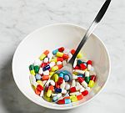
Pharming Parties or Trailmixing
Everyone brings prescription or OTC drugs
Pills placed in bowl
Everyone grabs a handful of pills
Alcohol may or may not be involved
Preferred drugs are chlorpheniramine and dextromethorphan

Slide 112

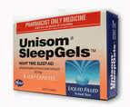
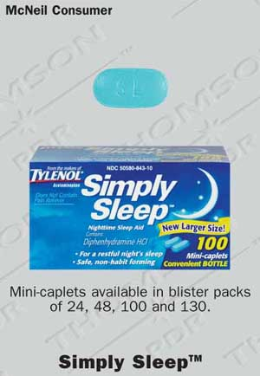
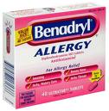
Diphenhydramine Abuse
High doses used for sleep or as sedative
Hallucinations can occur at doses of 150-700 mg
Can produce severe arrhythmias and add to sedative effect of other drugs or alcohol

Slide 113
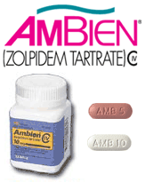
Ambien
Street names
  A-Minus
  Zombie Pills
Use larger doses and resist urge to sleep
Causes hallucinations and blackouts
Date rapes can occur during blackouts
Can cause fatalities especially if combined with alcohol
Somnambulism (sleep walking and sleep driving) occurs with all related agents

Slide 114
WASP
METHAMPHETAMINE + BUG SPRAY (HOT SHOT)
VIOLENT, AGGRESSIVE, IRRATIONAL BEHAVIOR

